Slide 1

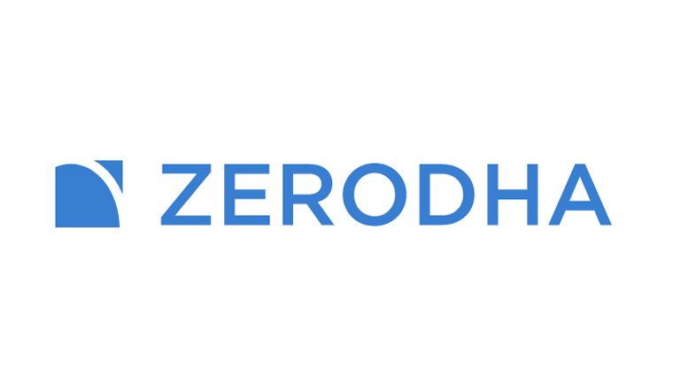
Case Study: Zerodha
Welcome to the case study of Zerodha, a fast-growing online trading platform.
Tagline:- Zerodha means No Obstruction

Slide 2


History of Zerodha
How did it start?
Founder Was working at a call centre at night and used to trade in stock market during morning at the age of 17.
Later in 2003 he started working with Reliance money as a sub-broker.
Lost a significant amount of money in global financial crisis in 2008-2009.
While working as a full-time trader for a decade, he faced problems which he then wanted to solve.

Slide 3



Brief:-
Founded by Nitin Kamath in 2010 in Bangalore.
Bootstrapped and profitable unicorn in 2020 .
Discount broking firm.
Accounts 15% of the retail trading volume
Employee about 1,100. people with a core team of 6.
1$ B
Valuation
1,100
Team

Slide 4



User Statistics and Growth Rate
With over 4 million registered users, Zerodha has witnessed exponential growth in recent years. Its user base has been increasing at an average rate of 300,000 users per year, making it a dominant force in the online trading industry.
Let's talk numbers (Revenue Model) :-
FY (2021)-
Revenue Rs. 850 Crores
Net Profit Rs. 350 Crores
(total client base increase is 40x to 2.8 million over past 5 years)
Nearly 30% increase of users during Covid-19 around 300,000 users per month since March
According to NSE, Zerodha's daily turnover is Rs. 2000/- Crore
2.8 M
Clients
300K
User adds/mth

Slide 5



Competitors in the Market
Groww
HDFC
UPSTOX
HDFC is a traditional brokerage firm that offers personalized services. Zerodha's focus on technology-driven solutions positions it as a disruptive player, appealing to a younger demographic seeking convenience and cost-effectiveness.
UPSTOX is a well-established brokerage firm with a large market share. However, Zerodha's competitive pricing and innovative platform have allowed it to gain significant ground in the market.
Groww is known for its advanced trading tools and research resources. While Zerodha may face competition in terms of features, its user-friendly interface and low-cost structure give it a distinctive edge.

Slide 6

Pros of Zerodha's Website and Company
1
Sleek and Intuitive Design
2
Accessible Knowledge Base
Zerodha's website boasts a modern and user-friendly interface, allowing traders to navigate effortlessly and execute trades seamlessly.
Zerodha provides an extensive library of educational resources, empowering traders with the knowledge they need to make informed decisions.
3
Transparent Pricing Structure
4
Innovative Features
Zerodha's straightforward pricing model eliminates hidden fees and ensures that traders have a clear understanding of their costs, enabling them to optimize their trading strategies.
Zerodha continually introduces innovative features, such as advanced charting tools and algorithmic trading options, to enhance the trading experience for its users.

Slide 7

Cons of Zerodha's Website and Company
1
Limited Offline Support
2
Learning Curve for Novice Traders
3
Market Volatility Risk
As with any investment, trading with Zerodha carries the inherent risk of market volatility, which can lead to potential financial losses. Traders should be aware of the risks and exercise caution.
Being primarily an online platform, Zerodha's customer support is predominantly online, which may pose a challenge for users who prefer direct assistance.
Zerodha's advanced trading tools and features may require a learning curve for inexperienced traders, although the platform does offer educational resources to aid their development.

Slide 8

Analysis:-
1
Number of Trades
Zerodha has witnessed a substantial increase in the number of trades executed on its platform, signifying its growing popularity and trust among traders.
User Satisfaction Ratings
2
User satisfaction ratings for Zerodha have consistently remained high due to its focus on providing a seamless trading experience and reliable customer service.
3
Growth Rate Comparison
When comparing Zerodha's growth rate to its competitors, it is evident that Zerodha has experienced remarkable expansion, solidifying its position in the market.

Slide 9

Future Plans
Upcoming goals for Zerodha is the aim to add 5- 10 million new investors of the Indian stock market with the aid of the platform. "India is very dependent on foreign capital to drive the country. For any country to do well, you need residents to put their money in the market. The money shouldn't just stay in fixed deposits and real estate. I want to encourage people to educate themselves and put the money in the ecosystem in some way or the other to drive growth," Nitin concluded.

Slide 10

THANK YOU!
BY:- Mayank Kumar Mishra
REG. NO.:- 219302169
DEPARTMENT:- Information Technology

